Slide 1
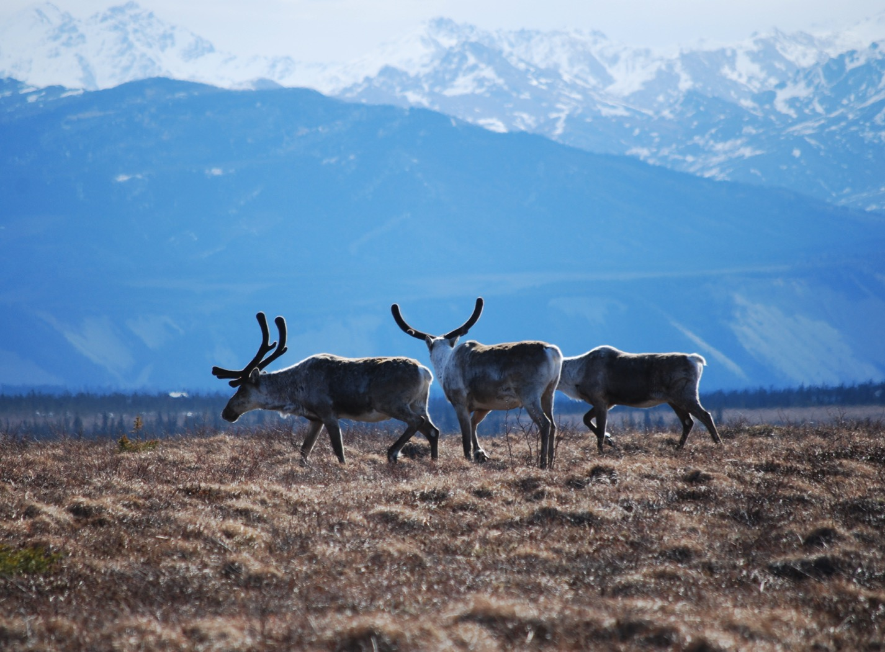
Arctic Boreal Vulnerability Experiment (ABoVE)
2017 ABoVE Airborne Campaign
6 June 2017 (DOY 157)
AirMOSS: North Slope
Charles Miller, Deputy Science Lead
Jet Propulsion Laboratory, California Institute of Technology
and the ABoVE Science Team For Hank Margolis, Eric Kasichke, Bruce Tagg
NASA HQ
Summer 2017

Slide 2
6 June 2017/DOY 157 North Slope
Assets Deployed:
Fairbanks (PAFA) – AirMOSS (P-band SAR)/JSC G-III (N992NA)
Science Coordinator: N Pinto
Science Lead: M Moghaddam
Project Manager: Y Lou
Mechanics: Johnny Scott, Jim Fennel
Operators: Phil Vaughn, Dave Elliot, Rocky Smith, Roger Chao, Joanne Shimada
Flight Number: P-12
Date (Z): 6 June 2017
Takeoff Location/Time (Z): PAFA/1855
Land Location/Time (Z): PAFA/2255
Flight Duration: 4.0
7 Day Rolling Total: 10.5
Mission: ABoVE/North Slope
Flight Plan: 745v3 and 1117v1
Crew: RYA/PRT/ROC/Thor
SOBs: Miller/Griffith

Slide 3
6 June 2017/DOY 157 North Slope
Daily Summary:
Science Flight
Aircraft Status:
Aircraft is up. Under APU power the bus voltage dipped below 100 volts before engine start and caused the AC power systems to drop and then recover. After engine start there were no issues. Note the APU output was 115v, but the bus voltage is was below 100v.
PPA: No issues
RADAR: No issues
Quote of the Day: "Beyond ABoVE 1..."
Route: PAFA BTT 6920N/15615W 7119N/15748W 7142N/15743W 6956N/15432W 6928N/15415W 7039N/15041W 7022N/15210W 6818N/15029W 6821N/14935W 7025N/15115W 7051N/14837W 6832N/14913W PAFA
Next flight: Wednesday at 0900, Ferry flight out of Fairbanks to Palmdale.

Slide 4
6 June 2017/DOY 157 72-Hour Look Ahead
All plans weather dependent
Wednesday 7 June May 2017 (DOY 158):
Transit to Palmdale
Download UAVSAR P-band from NASA 2
Shift data recorder to UAVSAR L-band
Thursday 8 June – Sunday 11 June 2017 (DOY 159-162):
Upload UAVSAR L-Band to NASA C-20
Ground testing
Test flight
Monday 12 June 2017 (DOY 163):
Transit to Yellowknife
Start UAVSAR L-band Campaign #1

Slide 5
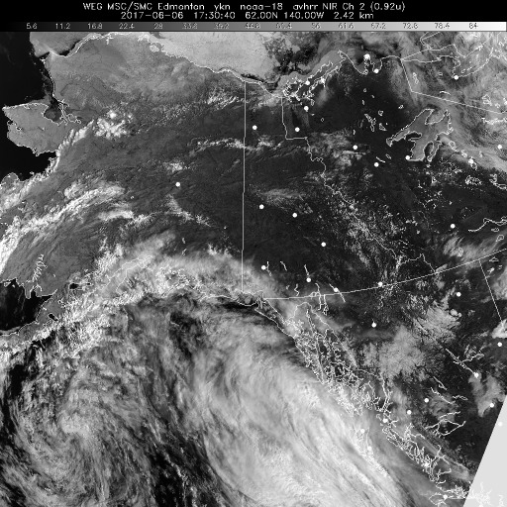
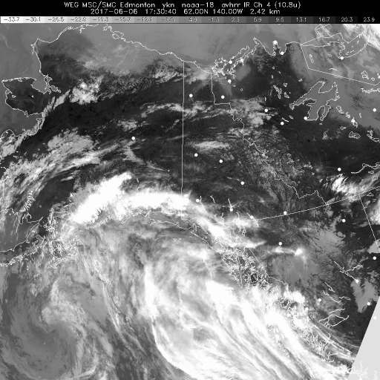
6 June 2017/DOY 157 North Slope
HRPT NIR
HRPT IR
HRPT Polar NIR (left) and IR (right) show low level coastal clouds with some clear patches on North Slope

Slide 6
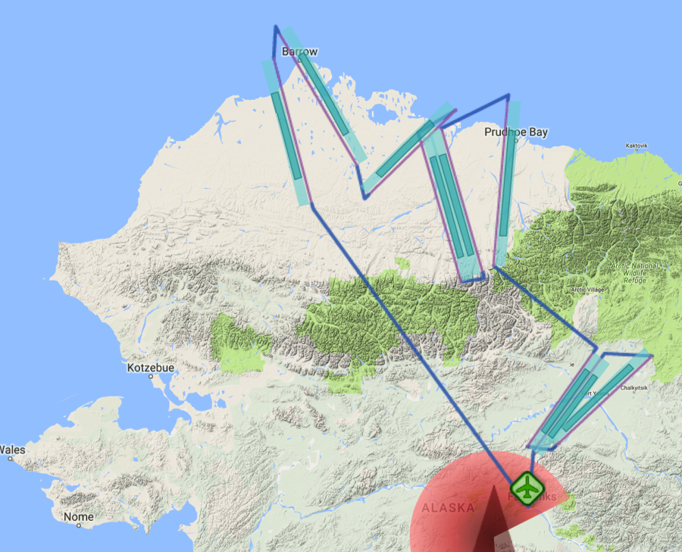
6 June 2017/DOY 157 North Slope
Flight Plan 1117 v02: Fairbanks AK (PAFA) – PAFA
https://uavsar.jpl.nasa.gov/cgi-bin/report.pl?planID=PLAN_1117_v02#flightPlan
Data Acquisitions:
Line 1, ID 34505: Atqasuk
Line 2, ID 15010: Barrow
Line 3, ID 04600: CALM
Line 4, ID 16404: Anaktuvuk 1
Line 5, ID 34407: Anaktuvuk 2
Line 6, ID 18517: Deadhorse
Line 7, ID 21507: Acquired 5/28/17
Line 8, ID 04706: Acquired 5/28/17
Line 9, ID 21608: Acquired 5/28/17
P-band keep-out zone shown in RED
(centered on Clear, AK: 64.29 N, 149.19 W)
15010
34505
04600
18517
16404
34407
21507
21608
04706
5/30/17 flight plan & acquisition segments
Notes:
Yukon Flats Lines 7-9 acquired on 5/29/17

Slide 7
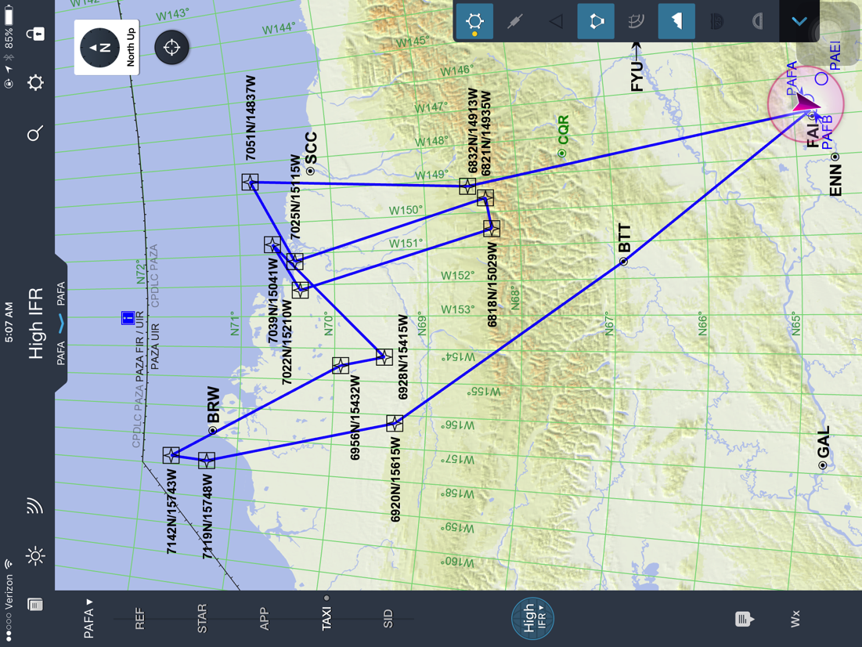
6 June 2017/DOY 157 North Slope
Pilot’s Flight Plan

Slide 8
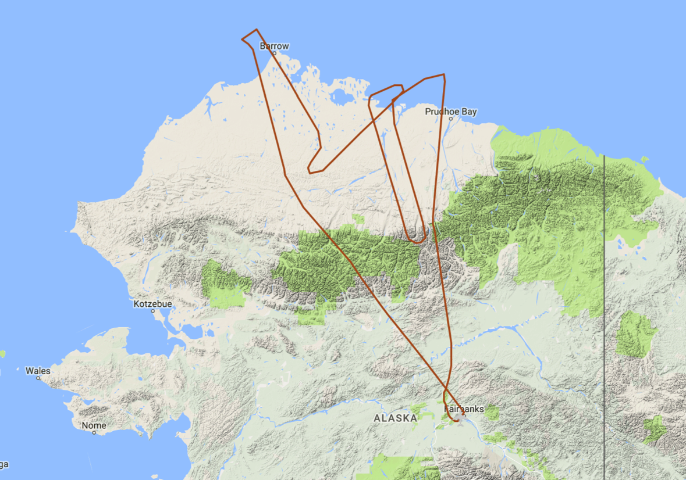
6 June 2017/DOY 157 North Slope
Actual Flight Lines
15010
34505
04600
18517
16404
34407

Slide 9
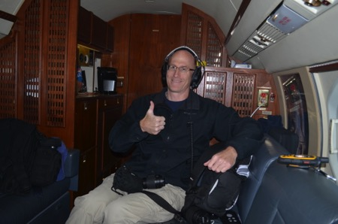
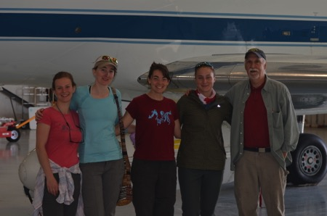
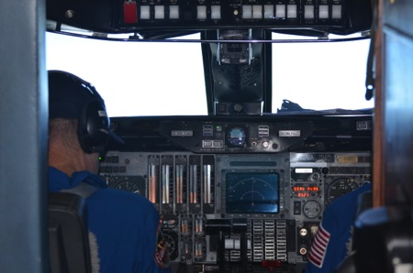
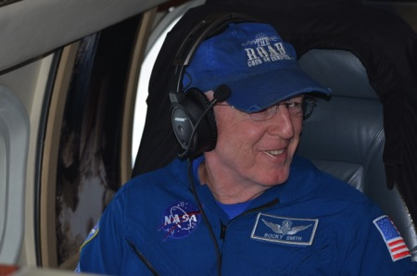
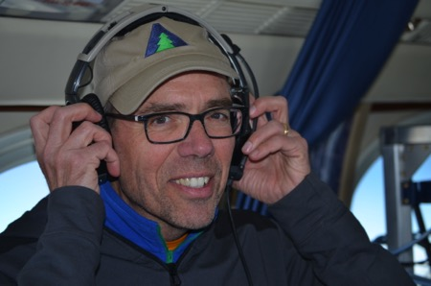
6 June 2017/DOY 157 North Slope
Stevens Village
Beaver
In-flight action

Slide 10
6 June 2017/DOY 157 North Slope
AirMOSS Quick-look products
A. Line 1, ID 34505: Atqasuk
B. Line 2, ID 15010: Barrow
C. Line 3, ID 04600: CALM
Joanne Shimada, JPL
A
B
C
Notes:
North Slope lakes were still ice-covered, resulting in a distinctive green false-coloring. Note that the lakes align SE-NW (slightly different orientation in each frame do to collection vector)
A: Extended sampling along the Meade River Valley from (L to R) the Brroks Range foothills into the lakes of the Arctic Coastal Plain
B: (L to R) Arctic Ocean – Barrow area then over the lakes of the Barrow peninsula
C: The Arctic Coastal Plain lake area west of the Colville River

Slide 11
6 June 2017/DOY 157 North Slope
AirMOSS Quick-look products
A. Line 4, ID 16404: Anaktuvuk 1
B. Line 5, ID 34407: Anaktuvuk 2
C. Line 6, ID 18517: Deadhorse
Joanne Shimada, JPL
A
B
C
Notes:
A&B: Overlapping samples of the Anaktuvuk River fire scar (opposite direction acquisitions) will be used to assess permafrost degradation
C: This swath covers the Dalton Highway and the myriad field measurements that have been performed along this route over the years

